Slide 1



Development of a Web-Based Product Catalog and Buyer Inquiry System for a Garment Manufacturing Unit
PROJECT MEMBERS
TEJASWINI K V – 23ITR165
VINOTHINI S – 23ITR171
(19ITR014)
PROJECT GUIDE
Ms. V. P. GAYATHRI
Assistant Professor/Department of IT
Kongu Engineering College

Slide 2
COMPANY DETAILS
Company Name :
Sree Anjaneya Exports
Owner :
M. Duraisamy
Address :
45, Chandrapuram East, Chitra Garden,
Tirupur - 641608
Contact :
Phone no: +9198432 43366
Email: sreeanjaneya@sify.com
2

Slide 3
PURPOSE OF THE PROJECT
PROBLEM STATEMENT
To develop a corporate platform for buyers to browse garment products online, as the company currently relies on manual communication methods such as emails and calls for product inquiries and order discussions.
SOLUTION
Develop a corporate website with a product catalog to:
Digitize product showcasing and buyer inquiries.
Enable structured sample request and tracking.
Improve global visibility and professional online presence.
3

Slide 4
OBJECTIVE
To design a professional corporate website for a garment exporter
To showcase products through a structured product catalog
To support business workflows digitally
To reduce manual inquiry and sample tracking processes
4

Slide 5
REQUIREMENTS OF THE PROJECT
HARDWARE REQUIREMENTS
Processor : Intel Pentium
Processor Speed : 250MHz to 667MHz
RAM : 8GB RAM
Hard Disk : 512GB
Keyboard : Standard 104 enhanced
Mouse : Local PS/2
SOFTWARE REQUIREMENTS
Platform : Visual Studio Code
Client-side Script : React
Responsive Design : CSS Media Queries
Server-side Script : PHP / Node.js
Database : MySQL
Web Server : Apache (XAMPP)
Browser : Google Chrome / Edge
5

Slide 6
TECHNOLOGY STACK
• Frontend:
React
• Backend:
Node.js, Express.js
• Database:
MongoDB
• APIs / Services:
Google Maps API, Email Service (SMTP / EmailJS)
• Tools:
Visual Studio Code, Git
6

Slide 7
LIST OF MODULES
Admin
Product Catalog Management
Buyer Inquiry Management
Sample Request & Tracking Management
Admin Authentication & Dashboard
User
Product browsing module
Buyer Pre-Qualification & Inquiry Submission
Sample Request Module
Sample Status Tracking
Contact & Location Access (Map Integration)
7

Slide 8
MODULE DESCRIPTION
USER MODULE
Product Browsing
View garment products by category with basic specifications.
Buyer Inquiry & Pre-Qualification
Submit structured export inquiries with company details.
Contact & Location Access
View company contact details and location using map integration.
8

Slide 9
MODULE DESCRIPTION
ADMIN MODULE
Admin Authentication & Dashboard
Secure login and overview of inquiries and requests.
Product Catalog Management
Add, update, and manage garment product listings.
Buyer Inquiry Management
Review and respond to qualified buyer inquiries.
9

Slide 10
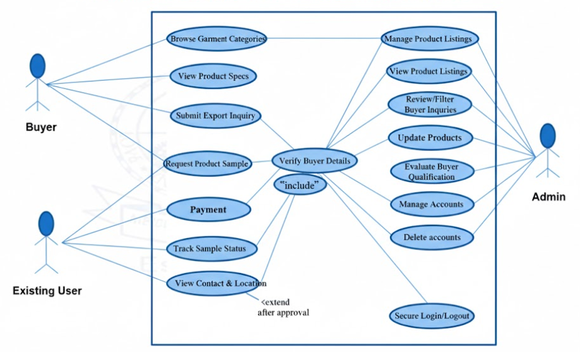
USECASE DIAGRAM

Slide 11
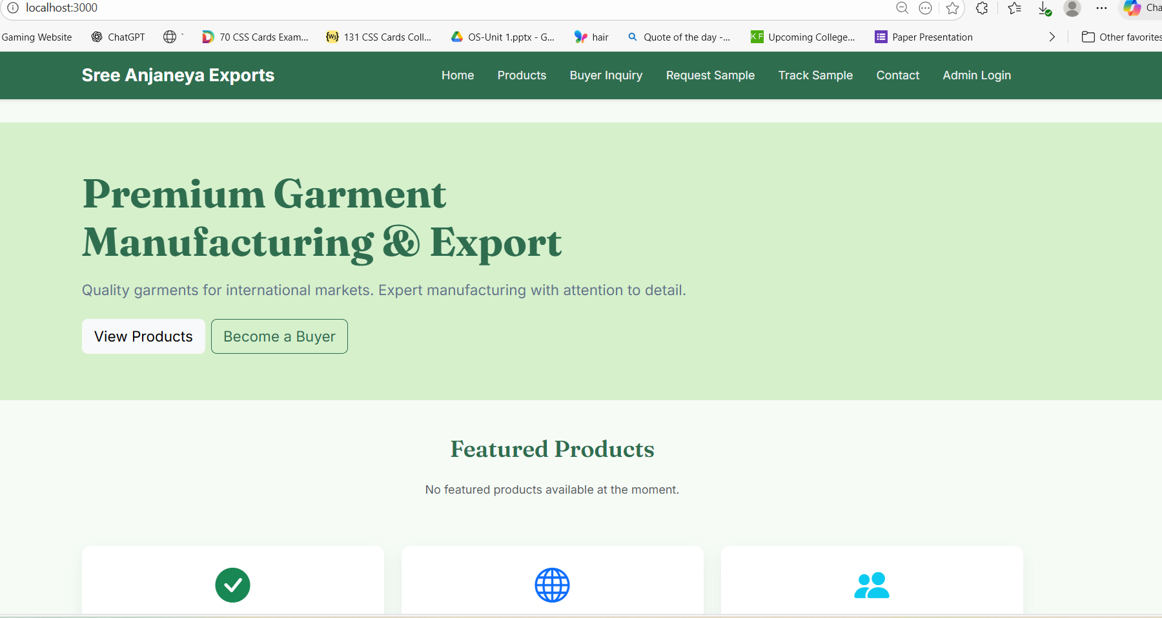
OUTPUT

Slide 12
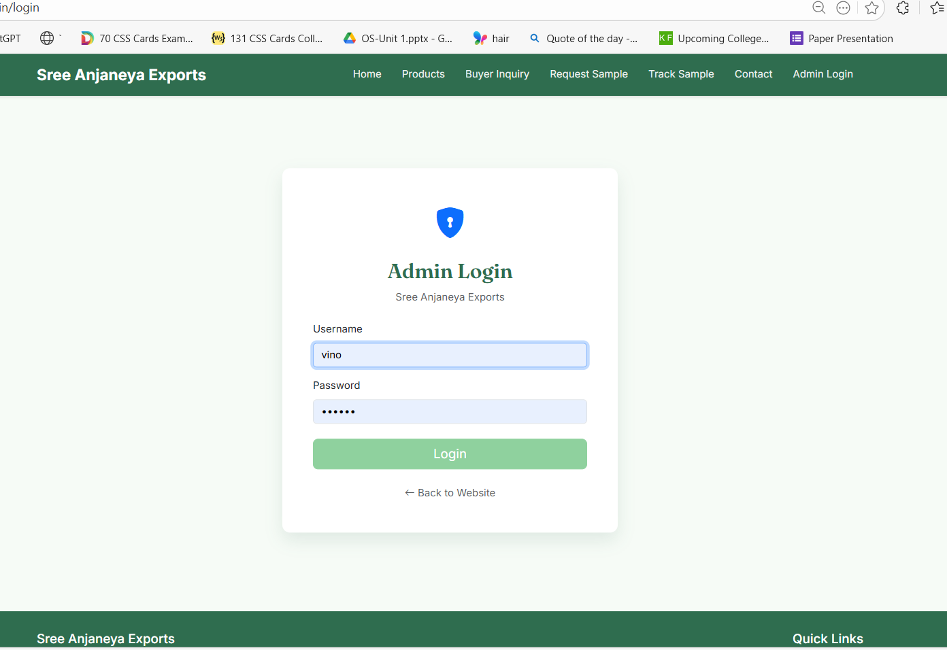
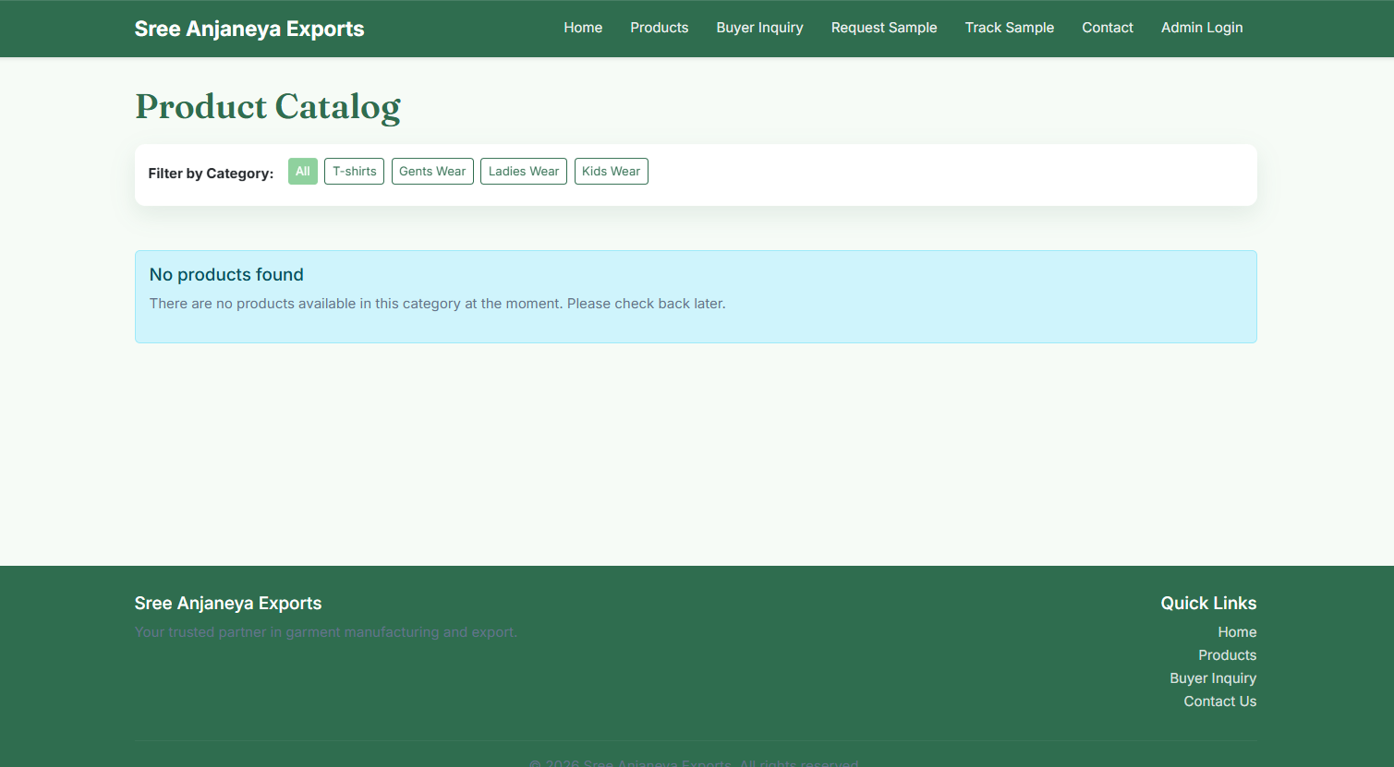

Slide 13
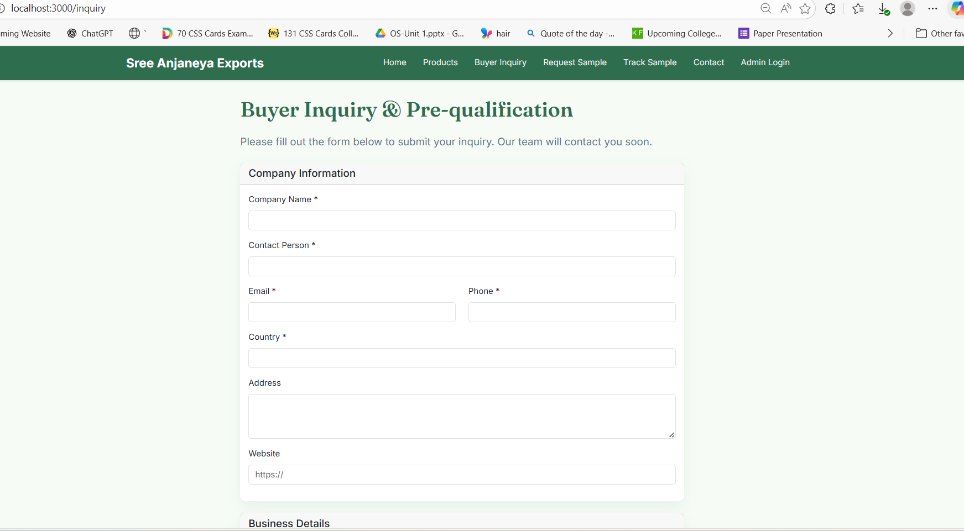
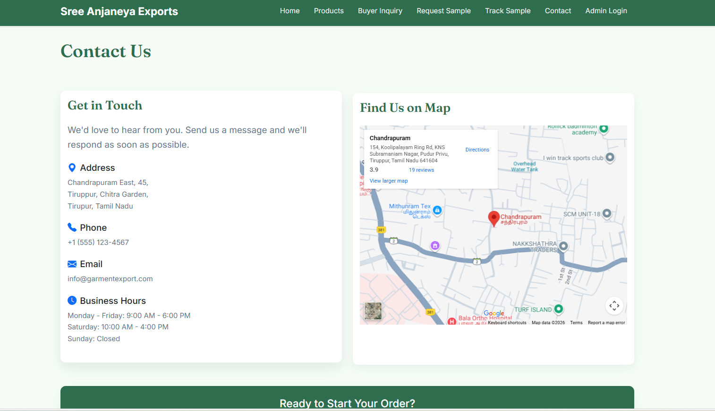

Slide 14
CONCLUSION
This project successfully develops a corporate website with a product catalog for a garment manufacturing and export company. The system improves digital presence, simplifies buyer inquiries, and supports export workflows such as sample requests and tracking. Overall, the solution enhances operational efficiency and provides a scalable platform for future business growth.

Slide 15
REFERENCES
Online Resources:
https://www.w3schools.com
https://developer.mozilla.org
https://www.mongodb.com/docs
https://nodejs.org/en/docs
https://developers.google.com/maps

Slide 16
THANK YOU
16

